Slide 1
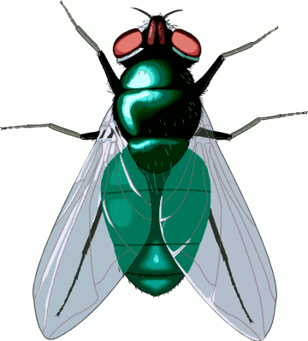


A Fly and a Flea
A fly and a flea, flew up in a flue.
Said the fly to the flea,
“What shall we do?”
“Let’s fly,” said the flea.
Let’s flee”, said the fly.
So they fluttered and flew .
Flew up in a flue.

