Slide 2
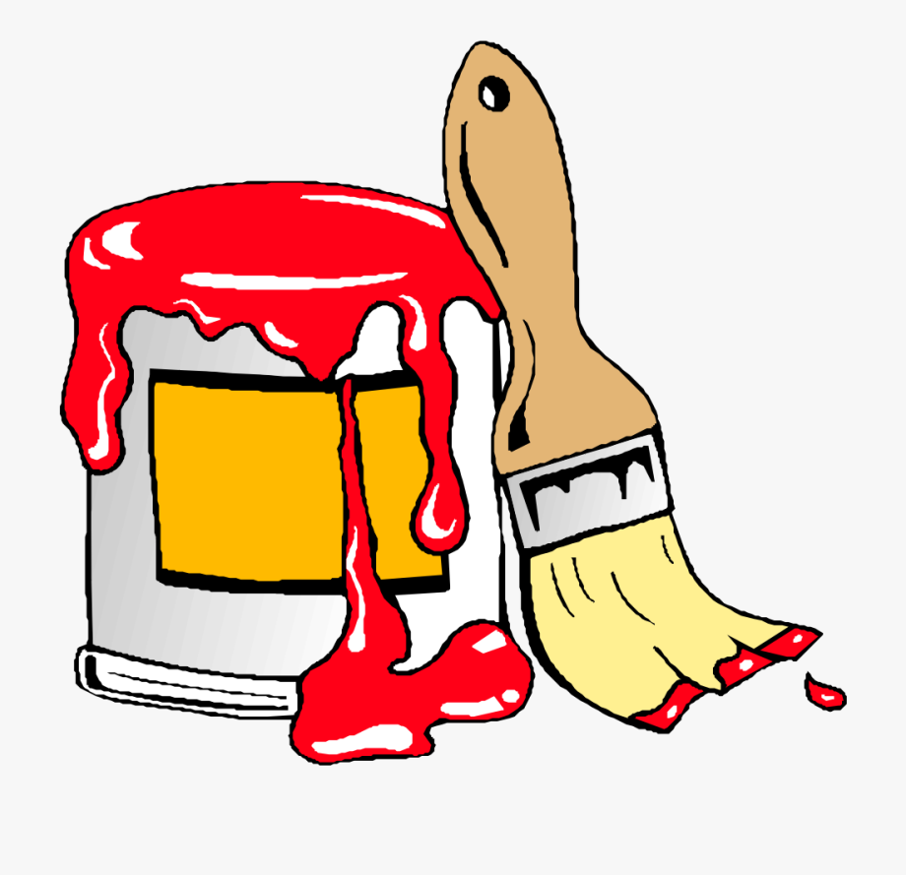
paint

Slide 3

feet

Slide 4

tulip

Slide 5

book

Slide 6

night

