Slide 1
Learning is Fun
Fill in the blanks:
“I love you through and through.
I will say it to my _______, ________, __________

Slide 2
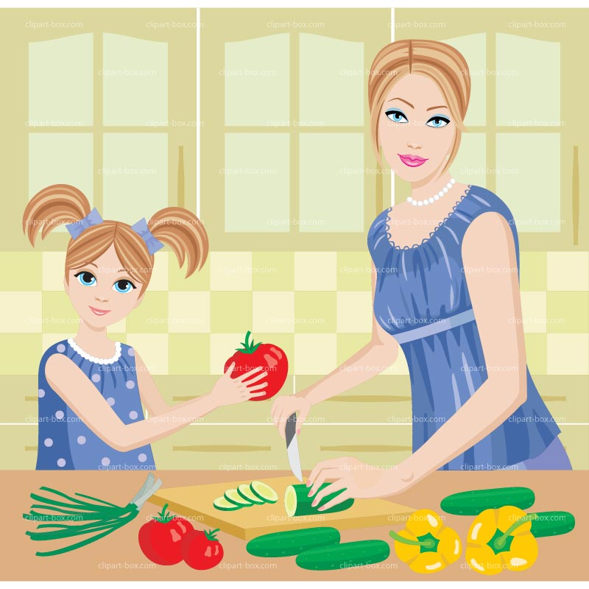
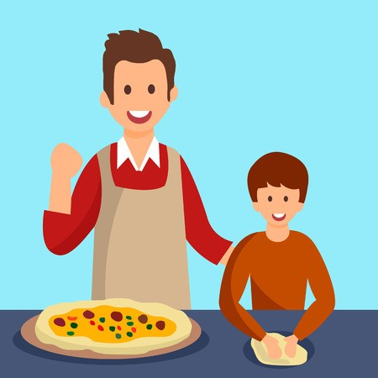
I love you Mommy, I will___________________.
I love you Daddy, I will ___________________.

Slide 3
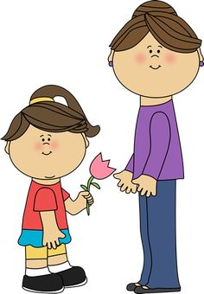
Draw a heart or a flower, and give it to the
Person you love.

